Slide 1

MOVIE RECOMMENDATION SYSTEM
TEAM : XPLORERS

Slide 2

INTRODUCTION
With the vast number of movies available across various platforms, it becomes difficult for users to find movies they will enjoy. This system aims to address this problem by providing personalized movie recommendations based on user preferences and previous movie ratings. Provide movie recommendations to users, improving their movie discovery experience.
The goal of this project is to build a recommendation system using machine learning techniques to suggest movies to users based on their past interactions and ratings. The system will aim to predict the most relevant movies for each user, enhancing their movie discovery experience.

Slide 3
TECHNOLOGY STACK
Languages: Python
Framework: Streamlit
Libraries/Tools: Pandas, NumPy, Scikit-Learn, Matplotlib, Seaborn.
Machine Learning Algorithms: Collaborative Filtering, Content-Based Filtering
Others: Jupyter Notebook (for development), Git (for version control), CircleCI

Slide 4
AUTHENTICATION & AUTHORIZATION
SSO Integration: Integrated Auth0 to provide a seamless Single Sign-On (SSO) experience.
Centralized Authentication: Users can log in once and access all linked features without needing to re-enter credentials.
Secure Access: Auth0 manages security tokens and user sessions, ensuring a secure and efficient login process.

Slide 5
DATASET OVERVIEW
Dataset Source: TMDb API (The Movie Database), CSV raw data
Dataset provides detailed information about the cast of movie, including:
Genre diversity
Temporal range
Financial spectrum
Language distribution
Runtime average
PostgreSQL on AWS RDS

Slide 6
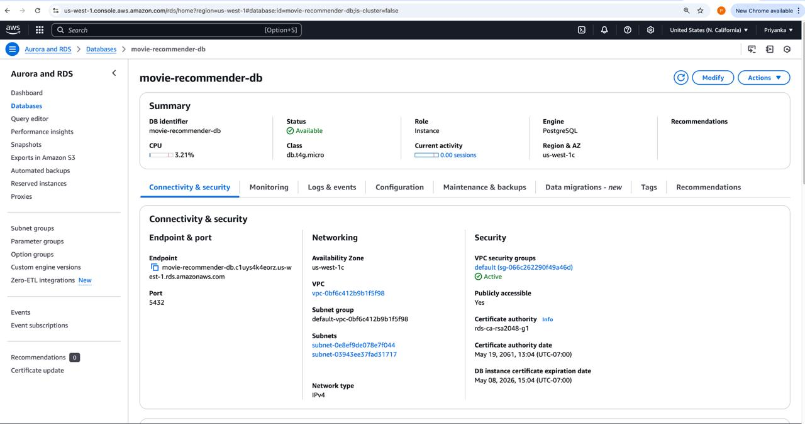
PostgreSQL DB on AWS RDS

Slide 7
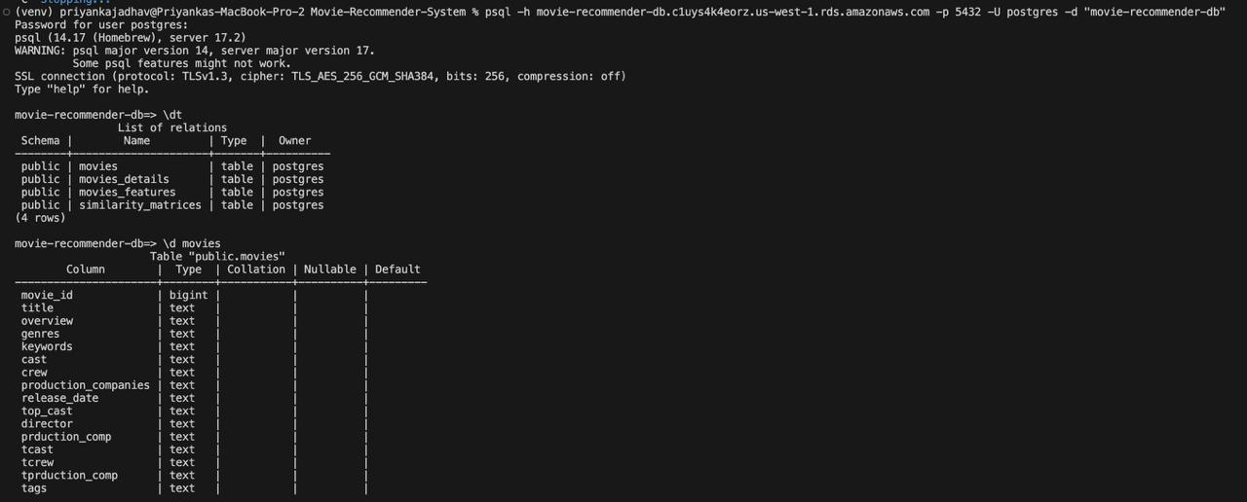
SCREENSHOT OF DATABASE TABLE

Slide 8
DATA PREPROCESSING
Data Cleaning:
Handled missing values by removing or imputing data.
Removed any duplicate records to ensure data integrity.
Feature Engineering:
Converted categorical variables like movie genres into numerical format (using one-hot encoding).
Created a user-item interaction matrix from the ratings data.
Normalization:
Scaled the ratings to ensure uniformity in the data.

Slide 9
RECOMMENDATION TECHNIQUES
Recommendation Generation Logic
When generating recommendations, our system:
Retrieves the pre-computed similarity vector for the selected movie
Ranks all other movies by similarity score
Filters the top 25 similar movies
Diversifies results by including recommendations from all five similarity types
Removes duplicates to ensure variety in suggestions

Slide 10
MODEL EVALUATION
Metrics
Quantitative Performance Assessment
Similarity Scores:
Genres: 0.84 avg. similarity
Keywords: 0.71 avg. similarity
Cast: 0.69 avg. similarity
Genre Consistency: 96% of recommendations share at least one genre
Response Time: 240ms average (well below 1-second threshold)
Diversity: 7.4 years standard deviation in release dates

Slide 11
MODEL EVALUATION
Model Evaluation - Case Studies
Qualitative Analysis
Action Movie Test: "The Dark Knight" → Batman series, other Christopher Nolan films
Sci-Fi Test: "Interstellar" → space exploration themes, visually stunning productions
Comedy Test: "The Hangover" → adult comedy, similar character dynamics
Key Finding: System effectively captures both explicit attributes (genre, director) and implicit thematic elements

Slide 12
Demo

Slide 13
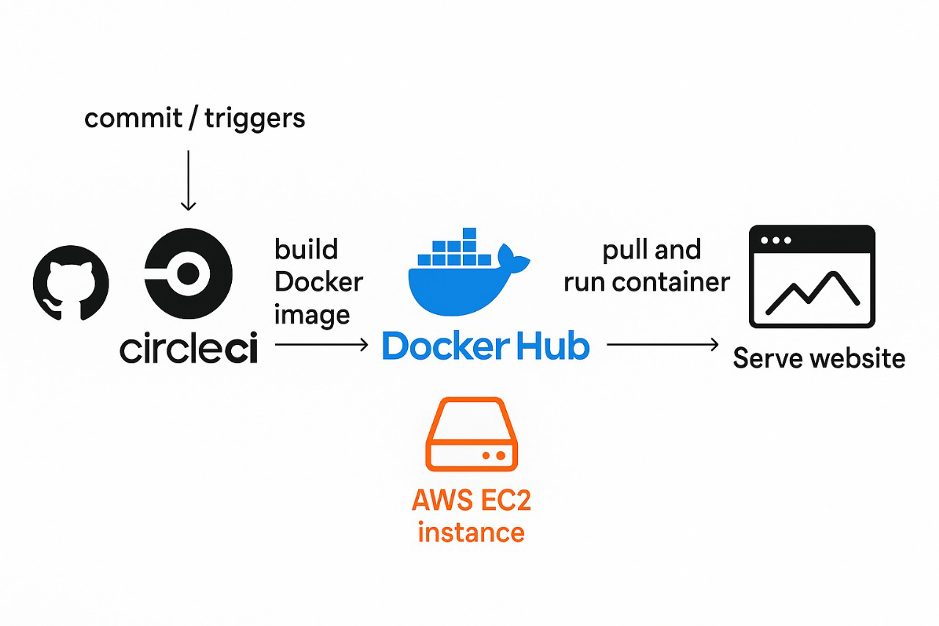
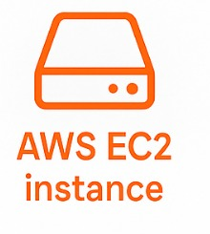
Deployment
GitHub

Slide 14
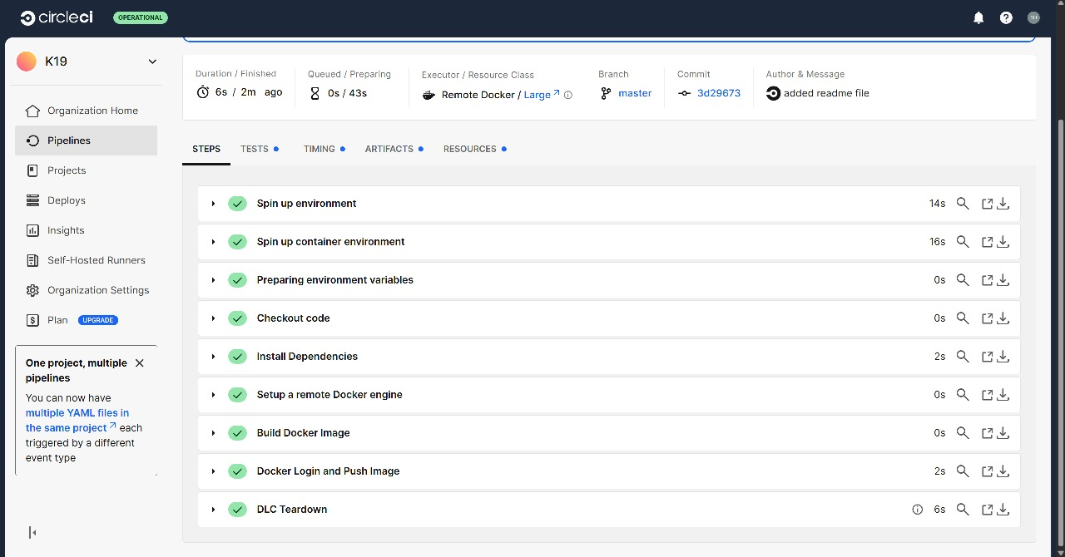
Deployment

Slide 15
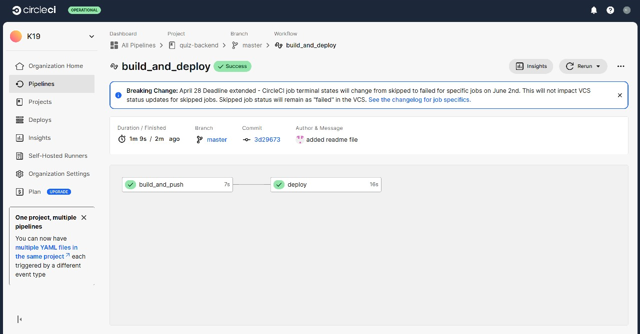
Deployment

Slide 16
RESULTS & INSIGHTS
Example Results:
"After training the model, we tested the system for a user who previously rated action and comedy movies highly. The system recommended similar movies like 'Kingsman: The Secret Service' and 'Zombieland' which the user had not yet watched but found enjoyable."
Key Insights:
The collaborative filtering model worked well when there were a lot of ratings data but struggled with new users who had limited data.
The content-based filtering helped recommend similar movies when collaborative data was sparse.

Slide 17
FUTURE ENHANCEMENTS
Hybrid Model: Combining both collaborative filtering and content-based filtering techniques to provide more accurate recommendations.
Deep Learning: Use neural networks to improve the model's accuracy and handle complex patterns in user behavior like user’s emotions, mood, interest.
Real-Time Recommendations: Implement a system where recommendations are updated dynamically based on user actions in real time.
Movie Links: Provide different platform links like Amazon Prime Video, Netflix, DisneyPlus, Hulu, etc. to watch the movies on.
A Better User Experience!

Slide 18

CONCLUSION
Summary:
"This movie recommendation system uses machine learning algorithms to predict movies that users are likely to enjoy based on their previous ratings and the characteristics of the movies."
Impact:
"The recommendation system enhances the user experience by helping users discover new movies that match their preferences. This can be deployed in platforms like Netflix, Hulu, etc."

